Slide 1
Domain Analysis

Slide 2
Chapter 12, Domain Analysis
((Chapter 12 is on the topic of domain analysis for object-oriented design
In brief, this means identifying classes, relationships between classes, and attributes of classes
The object-oriented approach given is very close to the modeling process for relational databases))

Slide 3
12.1 Overview of Analysis
((Analysis starts with some sort of vague statement of the problem to be solved
It involves taking a look at existing systems and talking to users of an old system or people who are requesting a new system (possibly the same people)
The goal is to arrive at an unambiguous specification for the new system
The diagram on the following overhead is supposed to summarize these ideas))

Slide 4
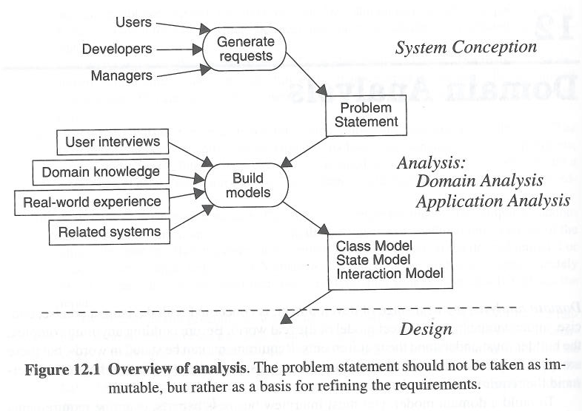

Slide 5
12.2 Domain Class Model
The following list summarizes the contents of the chapter, outlining the sequence of steps in analysis
Find classes. [12.2.1-12.2.2]
Prepare a data dictionary. [12.2.3]
Find associations. [12.2.4-12.2.5]
Find attributes of objects and links. [12.2.6-12.2.7]

Slide 6
Organize and simplify classes using inheritance. [12.2.8]
Verify that access paths exist for likely queries. [12.2.9]
Iterate and refine the model. [12.2.10]
Reconsider the level of abstraction. [12.2.11]
Group classes into packages. [12.2.12]

Slide 7
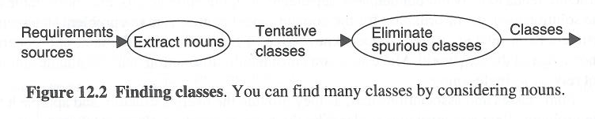
Finding Classes

Slide 8
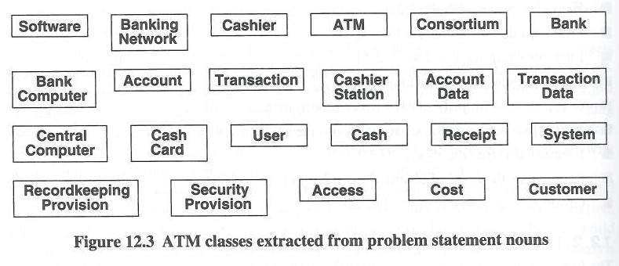

Slide 9
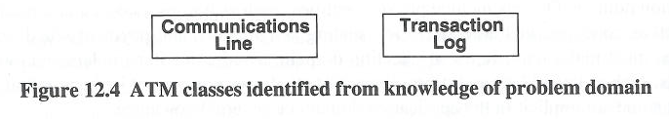

Slide 10
12.2.2 Keeping the Right Classes
The book has a list of the kinds of classes that can be eliminated from a design
The descriptive names alone may give an idea of why the classes are not suitable
In other cases further commentary is helpful
1. Redundant classes
ATM example: Customer and User are redundant
Customer is kept because it’s more descriptive
Customer and passenger in airline ticket booking system

Slide 11
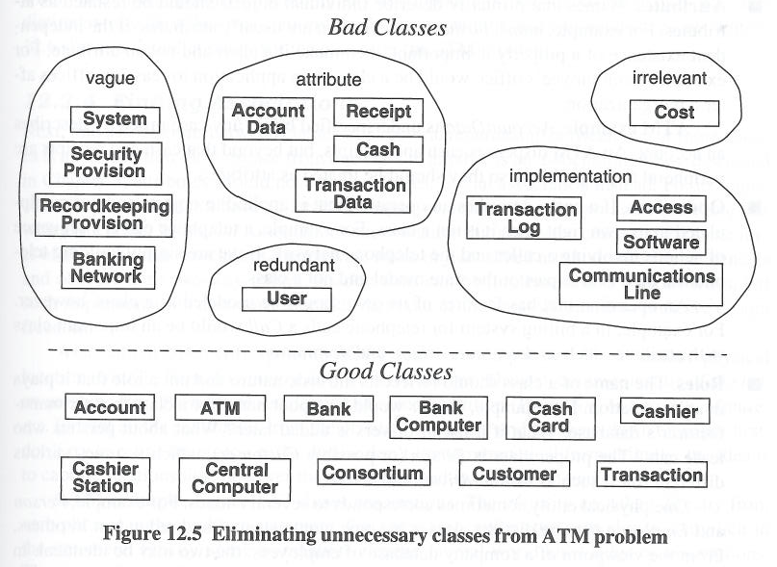

Slide 12
2. Irrelevant classes:
ATM example: Keeping track of Cost is beyond the scope of this application
In Theater ticket reservation system, the occupation of ticket holder is not important, occupation of theater personnel is important.
3. Vague classes
ATM example: Record Keeping Provision is vague
It is most likely part of a Transaction

Slide 13
4. Attributes
These are things you identify as nouns, but which are attributes of classes, not classes themselves
ATM example: Account Data is likely an attribute of an Account
5. Operations
Again, these are things that you identify as nouns, but which turn out to be things which would be implemented as methods within classes, not as classes

Slide 14
6. Roles
Think sub-type here.
A person may be an employee, a boss, a spouse, but a person is a person, not a role.
7. Implementation constructs
This is a danger whenever letting computer people design applications for users…
ATM example: TransactionLog and CommunicationsLine are instances of this

Slide 15
8. Derived classes
The meaning here is not too clear.
This does not mean eliminate subclasses specifically.
It does mean eliminate identified classes which could just as well be a kind of some other class.

Slide 16
The following overhead shows the ATM example again
Good classes are identified
Classes to be eliminated are classified according to which of the bad categories they fell into
Not all of the bad categories are illustrated, just five of them

Slide 17
12.2.3 Preparing a Data Dictionary
This is a deceptively simple requirement
From the O-O perspective it means that it should be possible to write a concise description of a valid class
//The book illustrates this with the figure shown on the next overhead
The relational requirement is more concrete
It should be possible to make a list of all tables and all fields of those tables, identifying the meanings of the fields and what domains they are on.

Slide 18
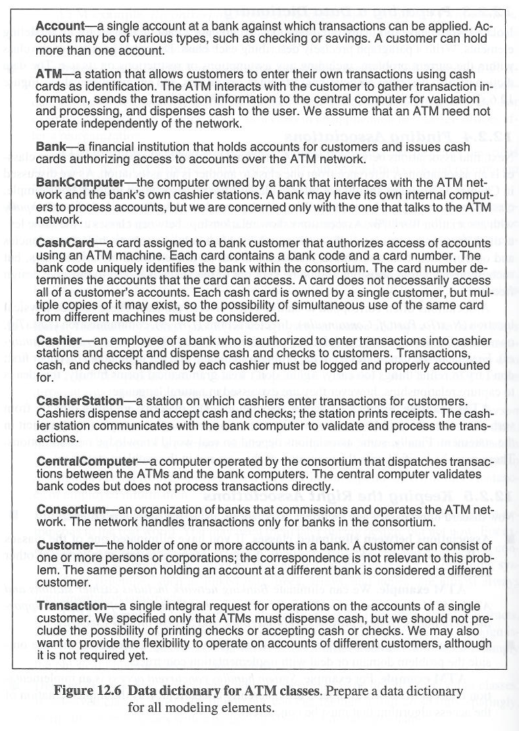

Slide 19
12.2.4 Finding Associations
Again, at this stage, the goal is not to find “is-a” inheritance relationships
It is to find “has-a” relationships
In O-O terms, most often this arises when one class has an instance variable that is a reference to an instance of another class
In a relational database, the relationship will eventually be captured by means of shared attributes (key pairs) but that lies in the future

Slide 20
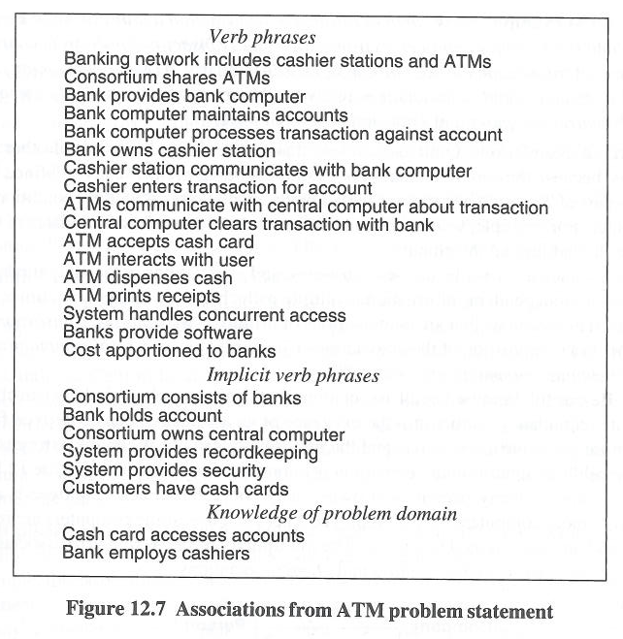

Slide 21
12.2.5 Keeping the Right Associations
Just like with classes, the first step at a design might tentatively identify associations that do not belong in the final design
Again, the book gives a list of the kinds of associations which should be thrown out:
1. Associations between eliminated classes
I guess it never hurts to state the obvious.
ATM example: There are many instances of this due to the number of eliminated classes

Slide 22
2. Irrelevant or implementation associations
Clearly, irrelevant associations don’t belong in a model
Likewise, when modeling, implementation concerns don’t belong
ATM example: System handles concurrent access
With multiple ATM’s, concurrency will occur
Reality is concurrent—but this is an implementation problem, not a design problem

Slide 23
3. Actions
Associations should embody structural relationships, not transient processing events
ATM example: ATM accepts cash card, ATM interacts with user, Central computer clears transaction with bank, and Central computer communicates with bank all describe t+ransient actions, not structural relationships

Slide 24
4. Ternary associations
This terminology is linked to database concerns
It is possible to have a three-way relationship among three different classes.
What they want to eliminate are cases where there are two base classes and the third item in the association description is just an attribute that is connected with the relationship
This idea will come up again when considering attributes

Slide 25
ATM example:
Bank computer processes transaction against account breaks down into Bank computer processes transaction and Transaction concerns account
Cashier enters transaction for account and ATMs communicate with central computer about transaction can also be broken into two binary associations

Slide 26
5. Derived associations
This is largely a warning against redundancy in the design.
If there is a relationship between classes and this ‘implies’ another relationship—possibly with a different name, but not differing in how things are related, then there is no need to capture the second relationship in the design.
The first relationship captures it all.

Slide 27
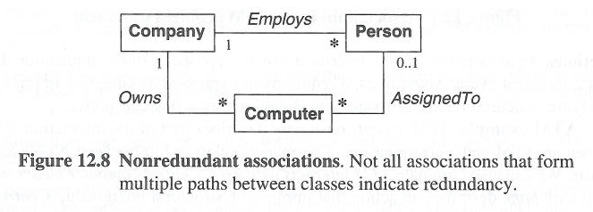

Slide 28
A company owns a set of computers
It also employs a set of employees
Employees are assigned to computers (or vice-versa)
The point is that AssignedTo is not a derived relationship
Which computer an employee is assigned to cannot be derived from the fact that an employee works for a given company

Slide 29
1. Misnamed associations
You eliminate them if they are redundant.
You rename them if they’re valid and not redundant.
Names should state what a relationship is, not be based on how it came about or some other extraneous description.
ATM example: Bank computer maintains accounts describes an action
Rename this Bank holds accounts

Slide 30
2. Association end names
Like in an E-R model, remember to label any ambiguous links

Slide 31
3. Qualified associations
This is a new aspect of UML notation
A qualifier distinguishes objects on the many side of an association
ATM example: The qualifier bankCode distinguishes the different banks in a consortium
This will be further explained just before the next UML diagram is shown

Slide 32
4. Multiplicity
When doing a first design, you can try to figure out the cardinalities of the ends of links, but you can always straighten out the details later.

Slide 33
5. Missing associations
Again, stating the obvious never hurts.
If you forgot something, add it to the design.
ATM example: The book suggests that all of these associations were forgotten in the foregoing list: Transaction entered on cashier station, Customers have accounts, Transaction authorized by cash card, and possibly Cashier authorized on cashier station

Slide 34
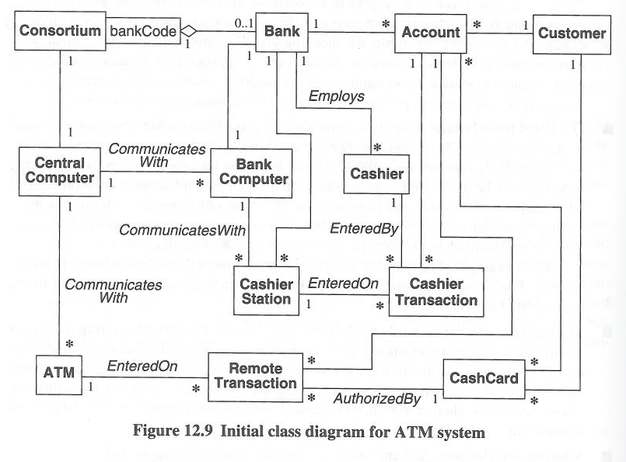

Slide 35
12.2.6 Finding Attributes
((The book suggests that attributes can be identified as nouns X, which appear in descriptions like these:
The X of Y
Y’s X
Just like with relational modeling, meaningful names are useful
Also, any attribute that can be calculated from other attributes is not a base attribute))

Slide 36
12.2.7 Keeping the Right Attributes
Just like with classes and associations, the first step at a design might tentatively identify attributes that do not belong in the final design
Again, the book gives a list of the kinds of attributes which should be thrown out:
1. Objects
If something is an object it’s not a simple attribute
However, note that instance variables can be object references

Slide 37
2. Qualifiers
This item illustrates an important difference between O-O modeling and relational modeling
What does the book mean by qualifier?
It gives an example:
Suppose you have a design with both Company and Person classes
Suppose you also identify an attribute with a qualified name like employeeNumber

Slide 38
3. Name
This is also kind of obscure, but tied to relational modeling concerns
If a name attribute has to be unique, then the book suggests that in an O-O model it is likely not an attribute
It is serving the moral purpose of a pk and its implementation is likely to end up being as part of a reference

Slide 39
4. Identifier
This is also at least in part related to relational design ideas
An identifier in an O-O setting might be a hash code for example
This is along the lines of a hidden record identifier in a table
This implementation level unique identifier does not belong to the set of domain level attributes of an object in an O-O design

Slide 40
5. Attributes on associations
This is another interesting point that will resonate with relational questions
The book gives an example:
membershipDate as an attribute on a many-to-many relationship

Slide 41
6. Internal values
If the attribute is not visible outside of the class, then it’s not necessary to include it in the modeling.
It’s an implementation issue
7. Fine detail
Fine detail can be ignored when modeling.
If necessary more detail can be included in a future iteration of the model

Slide 42
8. Boolean attributes
The book suggests that quite often more than two values become evident and a boolean can be modeled as an enumeration (a set)
Note also that in the end this is really an implementation issue
You don’t initially concern yourself with the types of attributes

Slide 43
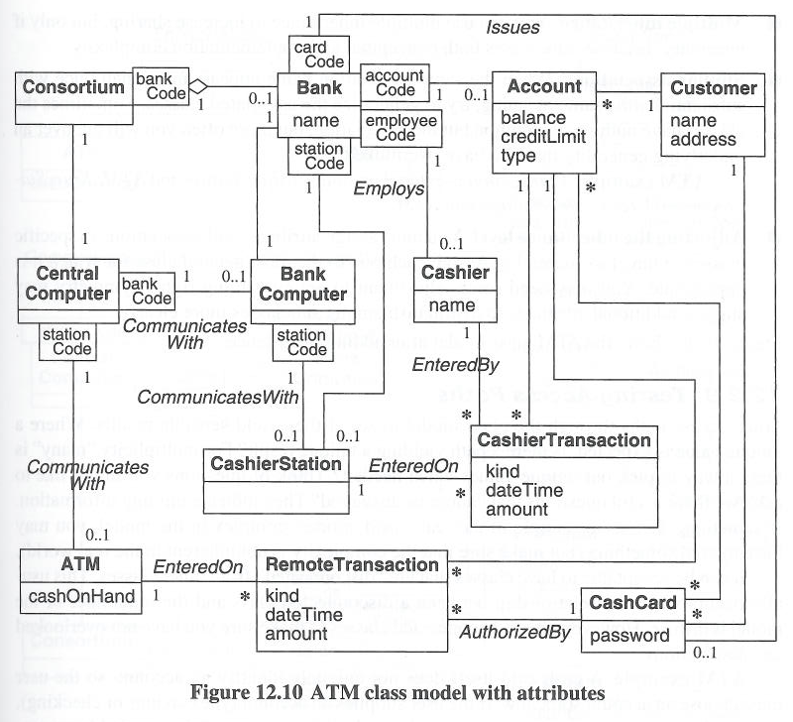

Slide 44
12.2.8 Refining with Inheritance
1. Bottom-up generalization
Find classes with similar attributes, operations, and associations
Implement common features in a super class.
2.Top-down generalization
We are analyzing from application domain.
Look for noun pharses in application

Slide 45
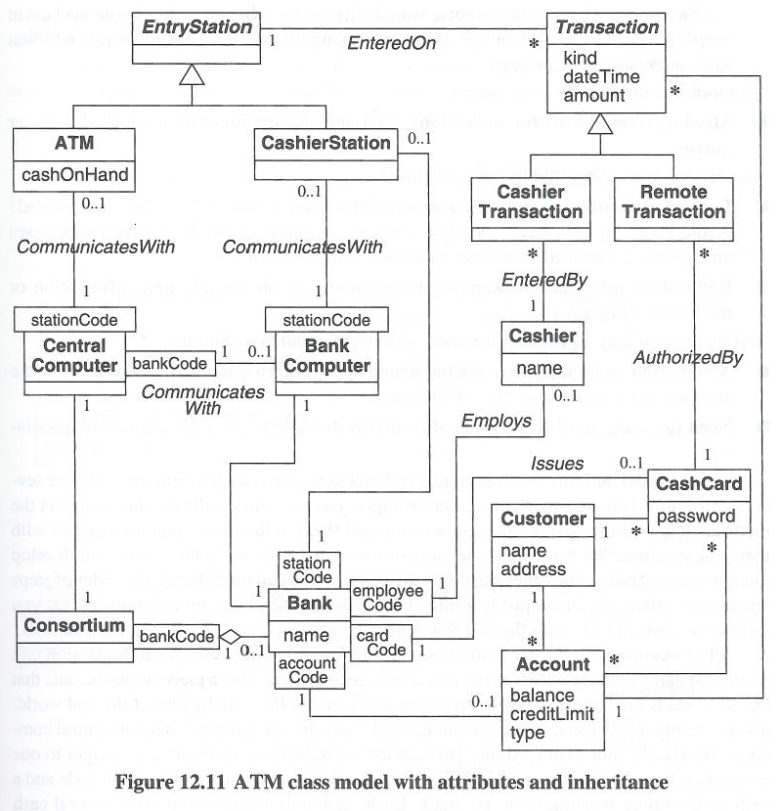

Slide 46
12.2.9 Testing Access Paths
((What this basically means is follow the associations shown in the model and test them
If you believe that ultimately there is a relationship between class X and class Y, it should be possible to get from class X to class Y by following links in the diagram))
This is related to relational design in the following sense:
The book expresses the idea as following associations in order to answer queries
In other words, the associations should exist so that you can find out what’s related to what

Slide 47
As you follow the links, it may be important to pay attention to their cardinalities and ask in particular whether it will be possible to uniquely identify which one of many is under consideration when following a particular path
Once again, this question should ring a bell for someone interested in relational design

Slide 48
12.2.11 Shifting the Level of Abstraction
The background to this section is the idea that every noun in the problem domain may lead to a class in the design
In an improved design, this may no longer be true
The book gives an example which is essentially the same as an example used to illustrate the concept in the database modeling notes given earlier

Slide 49
You may have employees and bosses
Ultimately, they are both types of person, or you might say, roles that people play
The book illustrates this with a three layer management hierarchy
This can be replaced with a class in a relationship with itself, as shown on the following overhead

Slide 50
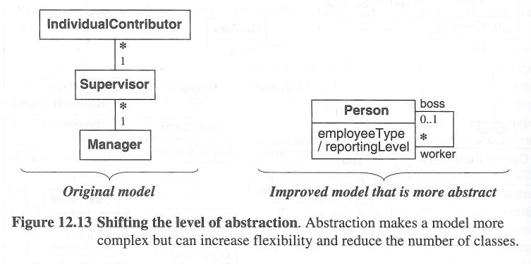

Slide 51
12.2.12 Grouping Classes into Packages
This is somewhat of a dark art, and even the ATM example is still too small to illustrate this realistically
The book gives two interesting ideas that are helpful in finally understanding how to go about this
1. In a sense, the motivation stems from UML diagrams
The goal is to divide classes into packages in a way that allows for clean UML diagrams

Slide 52
2. The separation of classes into packages also has semantic meaning
In other words, classes that are put together in one package should be more closely related than classes in different packages
The UML motivation and the semantic motivation are connected
If classes are semantically grouped, then the UML diagrams for the packages should be self-contained and consistent

Slide 53
Such a cut point class can be in both of the packages that it connects
Then when diagramming the model, subdivided into packages, there will be no lines between the packages
Their connection is embodied by the presence of the common class in each of them

Slide 54
As noted, the ATM model is still too small to be broken down into packages
However, the book suggests in outline form groupings that could become packages:
1. A teller package, including: cashier, entry station, cashier station, ATM

Slide 55
2. An account package, including: account, cash card, card authorization, customer, transaction, update, cashier transaction, remote transaction
3. A bank package, including: consortium, bank

Slide 56
12.3 Domain State Model
((Most objects in a model probably do not have states, or states worthy of modeling
Their use is concisely given by listing their attributes and operations))
However, some objects may pass through different states which are significant to the modeling of the system
In these cases it’s useful to develop a domain state model and diagram it

Slide 57
((These are the steps in constructing a domain state model:
1. Identify domain classes with states [12.3.1]
2. Find states [12.3.2]
3. Find events [12.3.3]
4. Build state diagrams [12.3.4]
5. Evaluate state diagrams [12.3.5]))

Slide 58
12.3.1 Identifying Classes with States
((Search for classes where objects of that class have an identifiable life cycle or history
This can be truly cyclic, where an object returns to an initial state))
It can also be progressive, running from one state to the next until the end
((EX-The ATM Account class is the only one with significant state))
Its life cycle is a mixture of progressive and cyclic changes of state

Slide 59
12.3.2 Finding States
((States, fundamentally, are captured by the values attributes have and the associations with particular other objects that a given object is in
Ex—Overdrawn(customer withdrawl more than the available balance)))
The idea of a state might arise from the problem domain, but it will be reflected in values associated with an instance
You might find a particular configuration of values and also decide that this represents a significant state in the model

Slide 60
States should be given a descriptive name that describes what they are, not how they came about
Although states are based on values, differences between states should be describable as differences in quality, not just quantity of some attribute, for example
The behavior of an object should be related to the state that it’s in

Slide 61
Not all states may be apparent before a model is complete
However, the idea that something has state should be identifiable earlier on
In the ATM model, the Account class has state.
Here are examples of particular states: Normal, Closed, Overdrawn, Suspended

Slide 62
12.3.3 Finding Events
((The events of interest are events that cause the states of objects to change
An easy analytical approach is to ask:
What causes a state to be initiated or entered?
What causes a state to end or be left?
Here are examples of events in the ATM model: Close account, withdraw excess funds, repeated incorrect PIN, suspected fraud, and administrative action))

Slide 63
Keep in mind that you’re modeling now, not coding
You are not interested in GUI events
You’re interested in domain events
Here are examples of events in the ATM model: Close account, withdraw excess funds, repeated incorrect PIN, suspected fraud, and administrative action

Slide 64
12.3.4 Building State Diagrams
((In the a diagram a state is an oval and an event/transition is an arrow
Analytically, for each state, you want to consider what events are possible))
For each state/event pair, you need to determine what other state, if any, this leads to

Slide 65
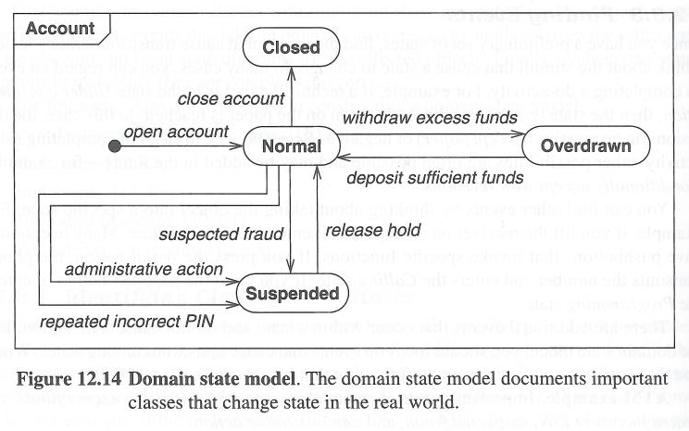
12.3.5 Evaluating State Diagrams ((read this full slide))examine each state model.and ask questions,are all the states are connected?are there any dead states that terminates the cycle

Slide 66
12.4 Domain Interaction Model
((This term refers to an analysis of user interactions with the system
It is not pursued here.))

Slide 67
12.5 Iterating the Analysis
((This is just a statement of the obvious
You typically have to go through the analysis process more than once
The first pass will give a first approximation
Following passes will refine the model))
This is not just the result of human failings
It stems from the fact that parts of the design depend on each other
You can’t understand one until you understand the other—and vice-versa

Slide 68
12.5.1 Refining the Analysis Model
((A large model will consist of multiple parts
When refining, you can work from the top down, using the divide and conquer approach
This works all the way down to individual classes and attributes))

Slide 69
((Signs of problems include:
1. Lots of classes that are similar, but not quite the same))
This is a sign of not having generalized correctly
In particular, you may have tried to generalize, but you should have generalized on an alternative set of shared attributes

Slide 70
2. (( You have combined more than one concept into a class))
This can happened because a physical entity has more than one logical aspect
You have tried to model the physical entity as one class
Instead, the different logical aspects should be modeled as separate classes

Slide 71
((3. If your model seems to embody many exceptions or special cases, that may be a sign that something was missed in analysis
4. If you expected certain things to appear symmetrically in the model, and they don’t, this may mean that you overlooked something (or had false expectations…)))

Slide 72
((5. A model may be inappropriate if it too rigidly captures details of current business practice))
A good model will be abstract enough that will allow for changes in specific business practices in the future
It is difficult to quantify flexibility and how much flexibility is needed, but it is still an important analysis concept

Slide 73
12.5.2 Restating the Requirements
((The model resulting from the analysis process may not agree exactly with the requirements that were given at the beginning of the process
Revised requirements should be explicitly written down, and they should be verified with the users who originally requested the system))

Slide 74
12.5.3 Analysis and Design
((Dividing analysis and design into two steps is a convenient application of divide and conquer))
The idea is that analysis proceeds without any preconceived ideas about how the system might be implemented
((The reality is that analysis is never done in a complete vacuum))

